Slide 1
Machine Learning
Dr.K DeviPriya
Assoc.Professor
Computer science and engineering
Lakireddy Bali Reddy College of Engineering
Mylavaram

Slide 2
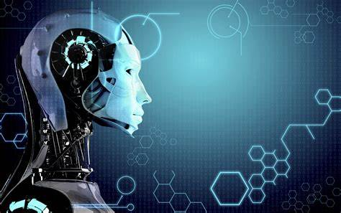
MACHINE LEARNING
MACHINE LEARNING
S

Slide 3
Quick questionnaire
1)How many of you have heard about Machine Learning?
2)How many of you know about Machine Learning?
3)How many people are using Machine Learning?

Slide 4
What are the things we are going to see
1)What is Machine Learning?
2)Why we need Machine Learning?
3)Applications of Machine Learning in Real World?

Slide 5
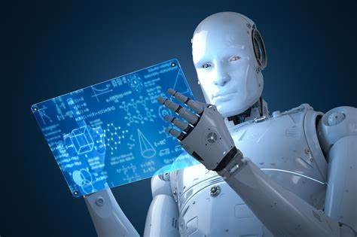
What is machine learning?
Machine learning is a "field of study that gives computers the ability to learn without being explicitly programmed."
--→Arthur Samuel

Slide 6
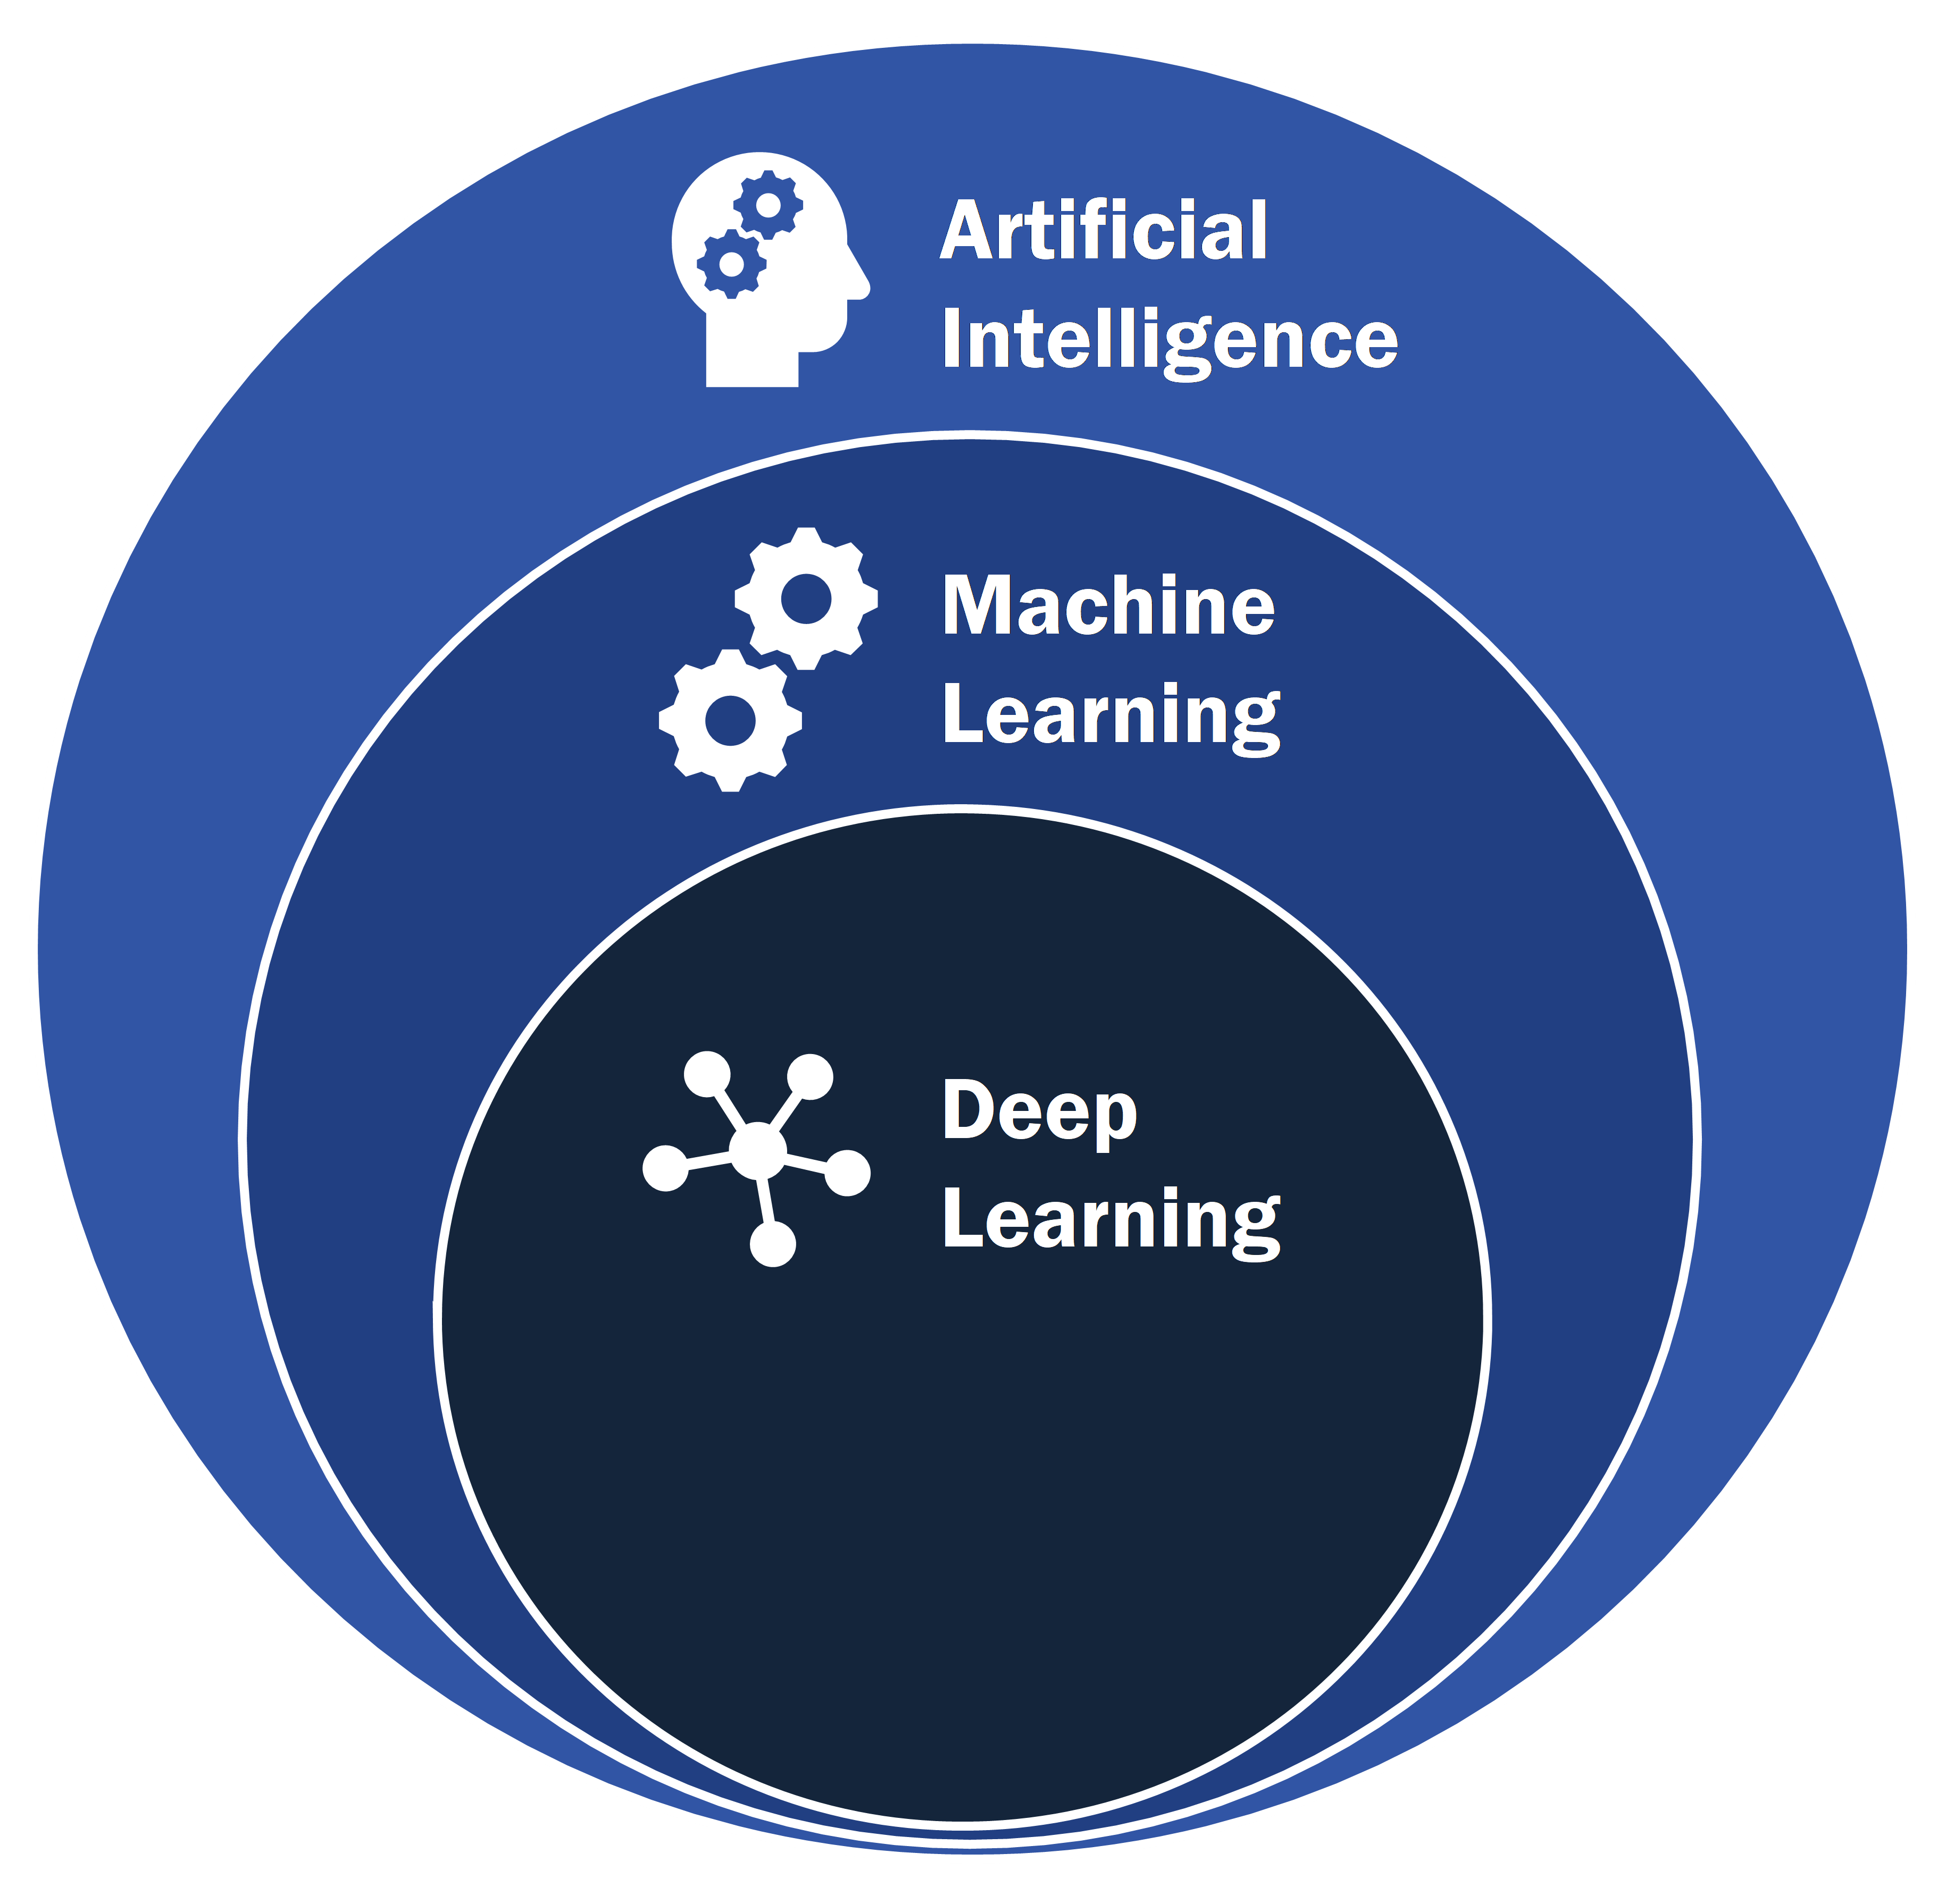

Slide 7
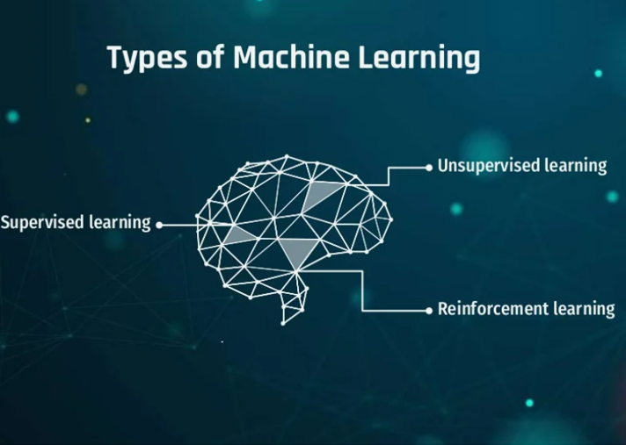

Slide 8
WHY we need MACHINE LEARNING?
Machine learning is important because it gives enterprises a view of trends in customer behavior and business operational patterns, as well as supports the development of new products.
Many of today's leading companies, such as Facebook, Google and Uber, make machine learning a central part of their operations.
Machine learning has become a significant competitive differentiator for many companies.

Slide 9
SPEECH RECOGNIZATION

Slide 10

Cyber security

Slide 11
PRODUCT RECOMMENDATIONS

Slide 12
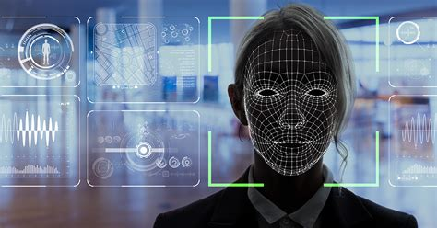
FACe recognization

Slide 13
Medical field

Slide 14
EMAIL SPAM DETECTION

Slide 15
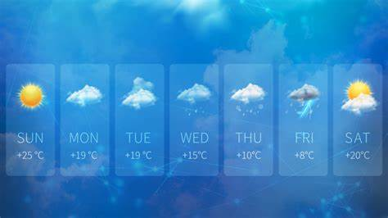
Weather predictions

Slide 16
Advantages of ML
Fast, Accurate, Efficient.
Automation of most applications.
Wide range of real life applications.
Enhanced cyber security and spam detection.
No human Intervention is needed.
Handling multi dimensional data.

Slide 18
Deep learning?
Deep learning differs from traditional machine learning techniques in that they can automatically learn representations from data such as images, video or text, without introducing hand-coded rules or human domain knowledge.

Slide 19
Deep learning?
Deep neural networks consist of multiple layers of interconnected nodes, each building upon the previous layer to refine and optimize the prediction or categorization.

